Slide 1
Deploying on Heroku
Olivier Liechti & Simon Oulevay
COMEM Web Services 2016

Slide 2

Heroku

Slide 3
What is Heroku?
Heroku is a cloud platform that lets companies build, deliver, monitor and scale apps — we're the fastest way to go from idea to URL, bypassing all those infrastructure headaches.
Heroku focuses relentlessly on apps and the developer experience around apps. Heroku lets companies of all sizes embrace the value of apps, not the distraction of hardware, nor the distraction of servers - virtual or otherwise.

Slide 4
Heroku and Git
GitHub repo
Heroku repo
origin
heroku
Heroku integrates with your Git workflow. When you register your app on Heroku, it will add a heroku remote to your repository.
To deploy the latest version of your app, make sure your changes are committed, and push your changes to the heroku remote:
Local repo
git push heroku master

Slide 5
Set up Heroku
Create a free account and install the Heroku toolbelt.
https://signup.heroku.com/
https://toolbelt.heroku.com/

Slide 6
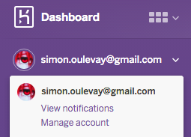

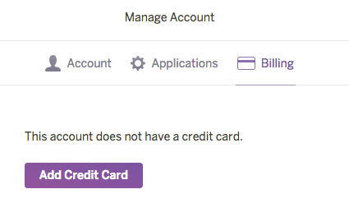

Add a credit card to your account (1)

Slide 7
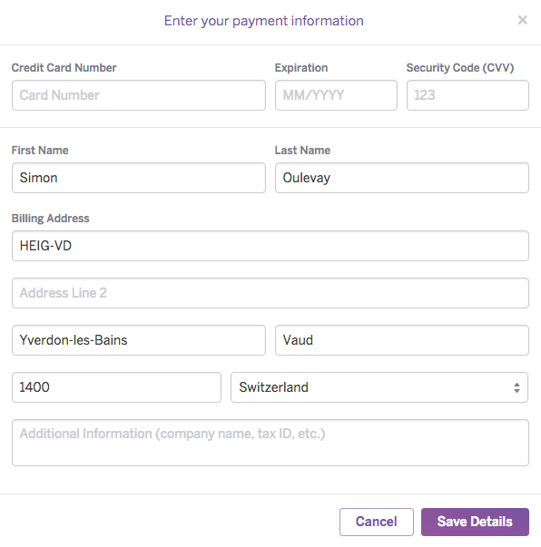
Add a credit card to your account (2)

Slide 8
Make sure you have an SSH key
$> ls -la ~/.ssh
id_rsa
id_rsa.pub
If you have those two files, then you already have an SSH key. id_rsa is the private key, id_rsa.pub is the public key.
$> ssh-keygen -t rsa -b 4096
Generating public/private rsa key pair.
Enter file in which to save the key (/Users/adam/.ssh/id_rsa):
Enter passphrase (empty for no passphrase):
Enter same passphrase again:
Your identification has been saved in /Users/adam/.ssh/id_rsa.
Your public key has been saved in /Users/adam/.ssh/id_rsa.pub.
If you don't have a key, generate one with ssh-keygen.
Make sure that the path to the .ssh directory is in your user's home folder (in this example, /Users/adam).
$> cd ~
$> pwd
/Users/adam
If you're not sure where your home folder is, use these commands.
https://devcenter.heroku.com/articles/keys

Slide 9
Add your app to Heroku
Run heroku create in your project's directory:
$> cd /path/to/repo
$> heroku create
Enter your Heroku credentials.
Email: john.doe@example.com
Password (typing will be hidden):
Logged in as john.doe@example.com
Creating app... done, stack is cedar-14
https://morning-reef-58678.herokuapp.com/ | https://git.heroku.com/morning-reef-58678.git

Slide 10
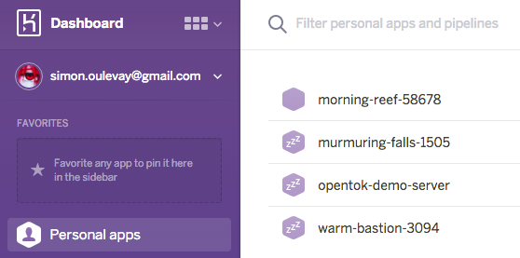
Find your application in Heroku

Slide 11
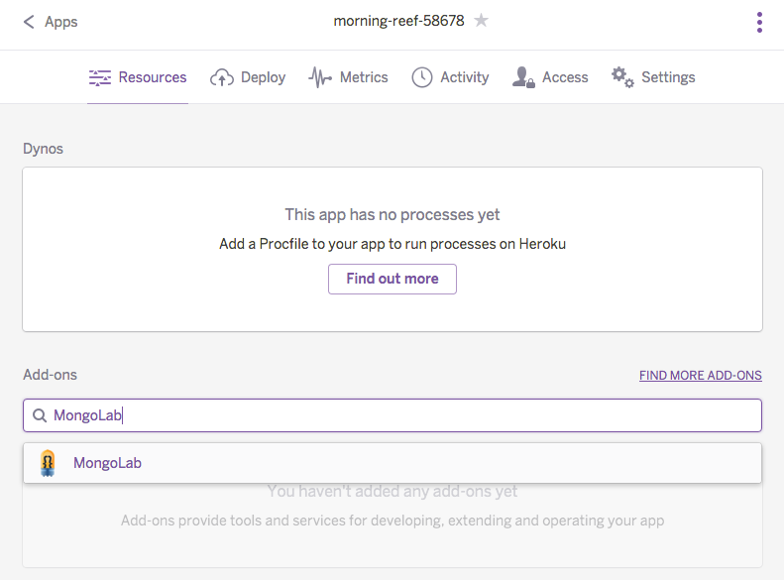

Adding MongoDB
Add the free version of the MongoLab plugin to your app:

Slide 12
Heroku environment
When you develop your Express application on your local machine, you are in what is called a development environment. You want code to be automatically reloaded, full error stack traces, and speed is not a major concern.
Heroku is a production environment. Here you want your code and assets to be cached for speed, and you do not want to reveal sensitive information to the user.

Slide 13
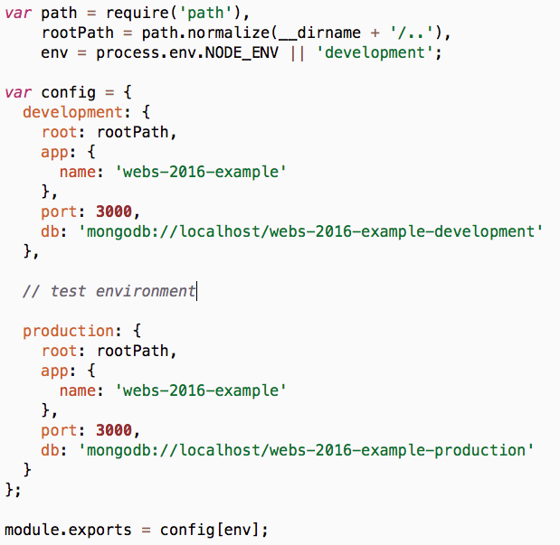
Express environment
config/config.js
Your Express app already has what it needs to be deployed in multiple environments.
A different section of the config object is loaded depending on the environment. This allows you to use a different port and database connection string for different environments.
Which environment is applied depends on the $NODE_ENV environment variable, which defaults to "development".

Slide 14

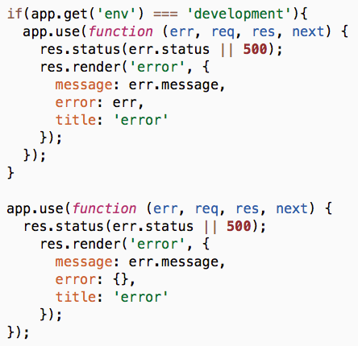
Express environment
Parts of your app will behave differently depending on the environment.
For example, error stack traces are shown to the user in the development environment, because you want to be able to debug the problem.
In the production environment, only the error message is shown, because you don't want to reveal sensitive information.
config/express.js

Slide 15
Update your production configuration
Heroku hosts your app on a shared server with other apps. Therefore, it will not use port 3000, but choose a random port number instead. This port number will be provided in the $PORT environment variable.
Similarly, the MongoDB connection string will be provided by the MongoLab plugin in the $MONGOLAB_URI environment variable.

Slide 16
JavaScript fallback
Update the configuration of your production environment to use these environment variables if they are available.
config/config.js
production: {
root: rootPath,
app: {
name: 'webs-2016-example'
},
port: process.env.PORT || 3000,
db: process.env.MONGOLAB_URI || 'mongodb://localhost/webs-2016-example-production'
}

Slide 17
JavaScript fallback
This syntax:
var port = process.env.PORT || 3000;
Is equivalent to this:
var port;
if (process.env.PORT) {
port = process.env.PORT;
} else {
port = 3000;
}

Slide 18
Push your app to Heroku
To deploy the latest version of your app to Heroku, simply push your master branch to the heroku remote.
$> git push heroku master
Counting objects: 44, done.
Delta compression using up to 8 threads.
Compressing objects: 100% (42/42), done.
Writing objects: 100% (44/44), 6.70 KiB | 0 bytes/s, done.
Total 44 (delta 8), reused 24 (delta 0)
remote: Compressing source files... done.
remote: Building source:
remote:
remote: -----> Node.js app detected
remote: -----> Creating runtime environment
remote: -----> Installing binaries
remote: -----> Restoring cache
remote: -----> Building dependencies
remote: -----> Caching build
remote: -----> Build succeeded!
remote: -----> Discovering process types
remote: -----> Compressing...
remote: -----> Launching...
remote: Released v4
remote: https://morning-reef-58678.herokuapp.com/ deployed to Heroku
remote:
remote: Verifying deploy... done.
To https://git.heroku.com/morning-reef-58678.git
* [new branch] master -> master

Slide 19
Check it out
When the deployment is done, Heroku gives you the link to your deployed app.
remote: -----> Launching...
remote: Released v4
remote: https://morning-reef-58678.herokuapp.com/ deployed to Heroku
remote:
remote: Verifying deploy... done.
To https://git.heroku.com/morning-reef-58678.git
* [new branch] master -> master

Slide 20
Not working?
Use heroku logs to check your app's logs on Heroku.
$> heroku logs
2016-02-24T18:58:53.725938+00:00 heroku[api]: Deploy 35191e8 by john.doe@example.com
2016-02-24T18:58:53.725938+00:00 heroku[api]: Release v6 created by john.doe@example.com
2016-02-24T18:58:55.207645+00:00 heroku[web.1]: Starting process with command `npm start`
2016-02-24T18:58:57.914290+00:00 app[web.1]:
2016-02-24T18:58:57.914288+00:00 app[web.1]: > webs-2016-example@0.0.1 start /app
2016-02-24T18:58:57.914290+00:00 app[web.1]: > node app.js
2016-02-24T18:58:57.914267+00:00 app[web.1]:
2016-02-24T18:58:53.844899+00:00 heroku[web.1]: State changed from crashed to starting
2016-02-24T18:58:58.676213+00:00 app[web.1]: Express server listening on port 34405
2016-02-24T18:58:58.891893+00:00 heroku[web.1]: State changed from starting to up
2016-02-24T18:59:00.193676+00:00 app[web.1]: GET / 200 24.217 ms - -
2016-02-24T18:59:01.205618+00:00 app[web.1]: GET /favicon.ico 404 552.827 ms - 240

Slide 21
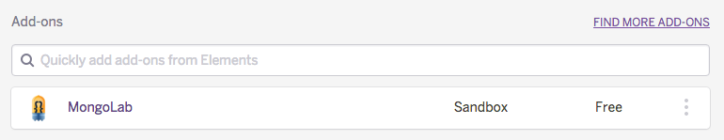
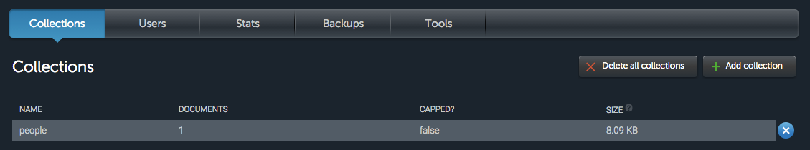
MongoLab database console

Slide 22
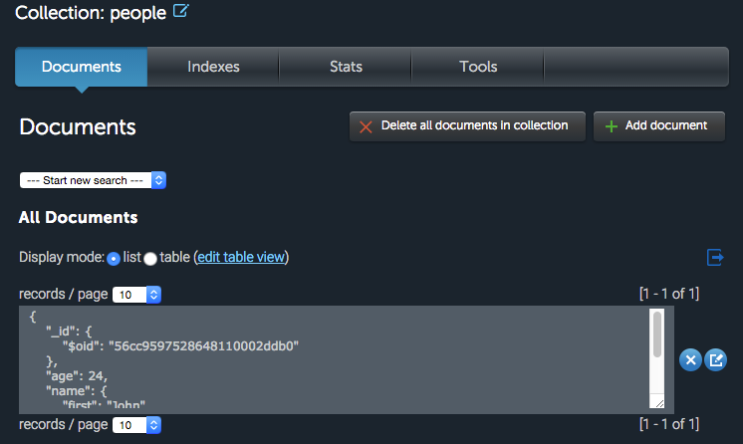
MongoLab database console

Slide 23
Heroku sleeps
Apps using the free dyno type have a sleep and a recharge behavior. Free dynos will sleep when a web dyno receives no web traffic for a period of time. In addition, if a free dyno exceeds a quota of 18 hours of activity during a 24 hour window, it will be forced to recharge.
https://devcenter.heroku.com/articles/dyno-sleeping
In other words: if you haven't used your Heroku app for a while, it's normal if it takes a few seconds to respond the first time.

Slide 24
Deploy your documentation

Slide 25
Single-page documentation
If your documentation is a single HTML page without separate assets (CSS/JS files), like grunt-raml2html produces, generate it into the public directory, and update the home controller to send it.
Where to save the generated documentation
Location of your RAML file(s)
Gruntfile.js
raml2html: {
all: {
files: {
'public/api.html': ['api.raml']
}
}
},
app/controllers/home.js
router.get('/', function (req, res, next) {
res.sendFile('api.html', {
root: 'public'
});
});

Slide 26
Documentation folder
If your documentation is a directory with multiple files, like grunt-apidoc produces, generate it into the public directory, and update the home controller to redirect to it.
Location of your API controllers
Where to save the generated documentation
Gruntfile.js
apidoc: {
all: {
src: "app/",
dest: "public/apidoc/"
}
},
app/controllers/home.js
router.get('/', function (req, res, next) {
res.redirect('/apidoc');
});

